Slide 1
Nunna Pravallika Sesha Sai FINAL PROJECT

Slide 2

Key – Stroke Logger
GITHUB LINK - https://github.com/pravallika-nunna/APSSDC-Key-Logger

Slide 3
Agenda
INTRODUCTION | 4
PROBLEM STATEMENT | 5
PROJECT WORKING | 6
COMPONENTS | 7-8
WOW IN THE SOLUTION | 9
END USERS | 10
RESULTS AND USER IMPACTS | 11
FUTURE PROPECTS | 12
CASE STUDY | 13
TYPES OF KEY - LOGGERS | 14
IMPORTANCE | 15

Slide 4

Definition: Keyloggers are software or hardware devices that record keystrokes typed on a keyboard.
Purpose: They are used to monitor and capture keystrokes, which can include usernames, passwords, and other sensitive information.
Applications: Keyloggers have both legitimate uses, like monitoring children's online activities, and malicious uses, such as stealing passwords or financial information.
INTRODUCTION
---- 4

Slide 5
PROBLEM STATEMENT
Objective: Develop a software keylogger to record keystrokes from a keyboard.
Implementation: Use Python with the PYNUT library for capturing and logging keystrokes.
Features: Capture keystrokes in plain text and JSON formats, with a Tkinter GUI for control.
Purpose: Educational and personal productivity tracking, ensuring legal and ethical use.
Constraints: Operate transparently and respect user privacy on personal devices.

Slide 6
PROJECT WORKING
Python script creates a basic keylogger with a graphical user interface (GUI) using the Tkinter library. When you run the script, a window opens with two buttons: "Start" and "Stop".
Start Keylogger: When you click the "Start" button, the keylogger begins capturing keystrokes from your keyboard in the background. It uses the PYNPUT library to monitor key presses and releases. Each keystroke event is recorded and categorized as "Pressed", "Held", or "Released" based on its state. The keystrokes are simultaneously logged into two separate files
:
Text File: key_log.txt records each keystroke sequentially.
JSON File: key_log.json stores the keystrokes in a structured format using JSON, with each entry indicating the type of key event and the key pressed.
Stop Keylogger: Clicking the "Stop" button terminates the keylogger's operation. The GUI updates to show that the keylogger has stopped, and both logging files are closed.
The keylogger operates solely on your local machine and does not transmit data over the Internet. It's designed for educational purposes and personal productivity tracking, allowing you to see how keystrokes are captured and logged programmatically.

Slide 7
COMPONENTS OF THE PROJECT
1. Tkinter GUI:
Purpose: Provides buttons to start and stop the keylogger.
Components:
Start Button: Initiates the keylogger.
Stop Button: Halts the keylogger.
Status Label: Displays messages about the keylogger's state.
2. Keylogger Functionality:
Purpose: Captures and logs keystrokes from the keyboard.
Operations:
on_press(): Records when keys are pressed.
on_release(): Records when keys are released.
generate_text_log(): Logs keystrokes in a text file.
generate_json_file(): Logs keystrokes in a JSON file.
3. Logging Files:
Purpose: Stores keystrokes in different formats for analysis.
Files:
key_log.txt: Stores keystrokes in plain text.
key_log.json: Stores keystrokes in structured JSON format.

Slide 8
COMPONENTS OF THE PROJECT
4. User Interface Feedback:
Purpose: Updates the user on the keylogger's activity.
Feedback:
Displays messages like "Keylogger is running!" or "Keylogger stopped." based on the current state.
Enables or disables buttons based on whether the keylogger is active.
5. Execution:
Running: Execute the Python script to open the GUI.
Interaction: Click the buttons to control the keylogger.

Slide 9
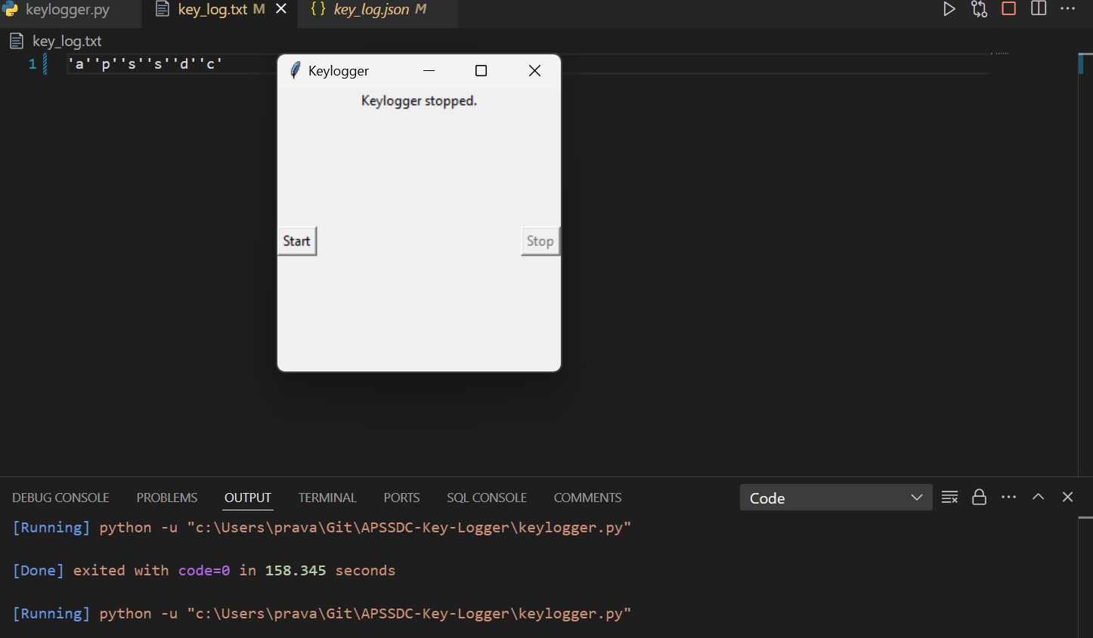
THE WOW IN THE PROJECT
THE CAPTURED KEYS ARE STORED IN A TXT AND JSON FILES.

Slide 10

END USERS
Primary End User: The person who runs the keylogger on their own computer to monitor their own activities or for educational purposes.
Usage: End users interact with the simple graphical interface to start and stop the keylogger and may review the logged keystrokes in the text and JSON files.

Slide 11
RESULTS AND USER IMPACT
Result: The keylogger captures and logs keystrokes in both text and JSON formats.
User Impact:
Educational: Users can learn about keylogging and Python programming.
Personal Use: Helps users track their computer usage for productivity purposes.
Ethical Considerations: Ensure legal and ethical use, respecting privacy and transparency.

Slide 12
FUTURE PROSPECTS
Enhanced Logging and Analysis:
Prospect: Enhance the keylogger to capture detailed information, including keystrokes specific to applications and timestamps.
Application: This improvement will provide comprehensive insights into how time is spent on various tasks, offering detailed records of user activities.
Advanced Security Features:
Prospect: Introduce encryption techniques to secure the logged data, ensuring protection from unauthorized access.
Application: This enhancement will safeguard sensitive information, such as passwords, by preventing exposure in plain text.

Slide 13
CASE STUDY
VV
Case Study: A parent installs a software keylogger on their child's computer to monitor their online activities and ensure they are safe from online threats.
Purpose: Ensures parental control and safety measures for children using the internet.

Slide 14
TYPES OF KEYLOGGERS
Software Keyloggers: Installed as software on a computer to record keystrokes, used for monitoring and security purposes.
Hardware Keyloggers: Physical devices plugged between a keyboard and computer to intercept and log keystrokes, often used in forensic investigations.
Wireless Keyloggers: Capture keystrokes transmitted over wireless connections (Bluetooth, Wi-Fi) to monitor computer activity remotely
.
Kernel Keyloggers: Operate at the kernel level of an operating system, making them harder to detect, typically used in sophisticated attacks.
Remote Administration Tools (RATs): Legal tools that provide remote access to a computer, can be used for monitoring and managing systems.

Slide 15
IMPORTANCE
Security Monitoring: Keyloggers detect unauthorized access by recording keystrokes, including passwords.
Forensic Investigations: They provide evidence in digital forensics to understand criminal activities.
Parental Control and Employee Monitoring: Used to monitor online activities for safety and productivity.
Educational and Training: Keyloggers teach cybersecurity and demonstrate vulnerabilities.
Personal Productivity: They track computer usage to improve time management and task efficiency.
GitHub Link - https://github.com/pravallika-nunna/APSSDC-Key-Logger

